Slide 1




Fernando Artigas

Slide 2



Slide 3

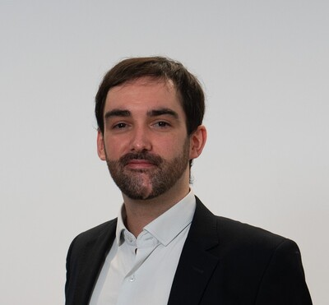


Who is this dude?
Remember:
Business people love suits…

Slide 4

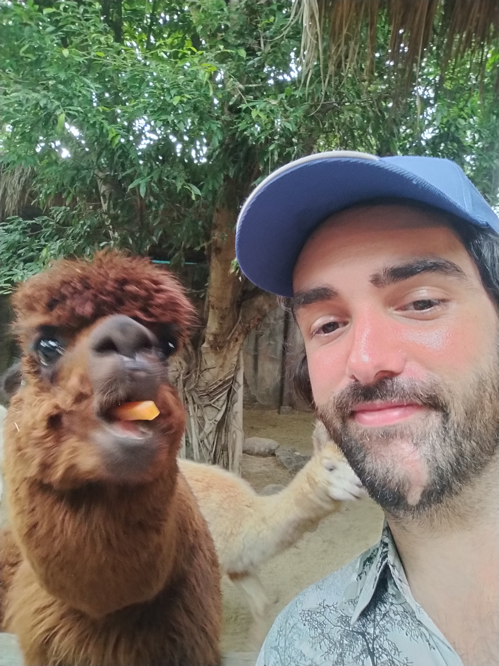

Who is this dude?
But…
when there is no ERP drama they don’t care about the lama!

Slide 5
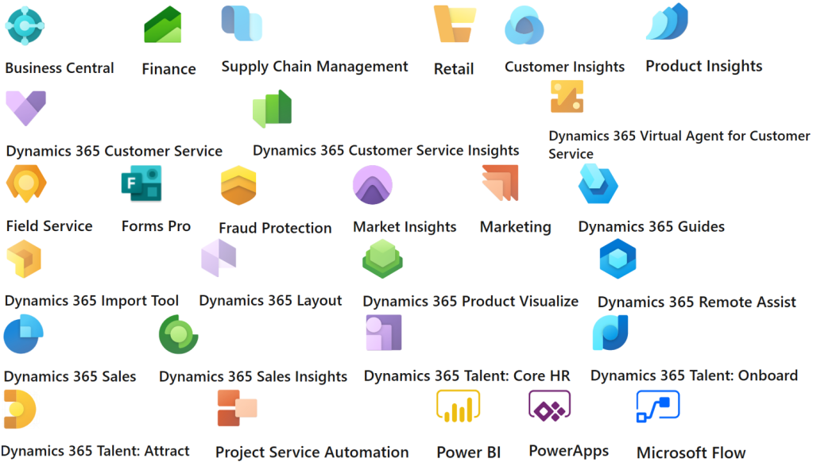
What is Microsoft Dynamics?

Slide 6

What is Microsoft Dynamics?
What Roles do we have?

Slide 7
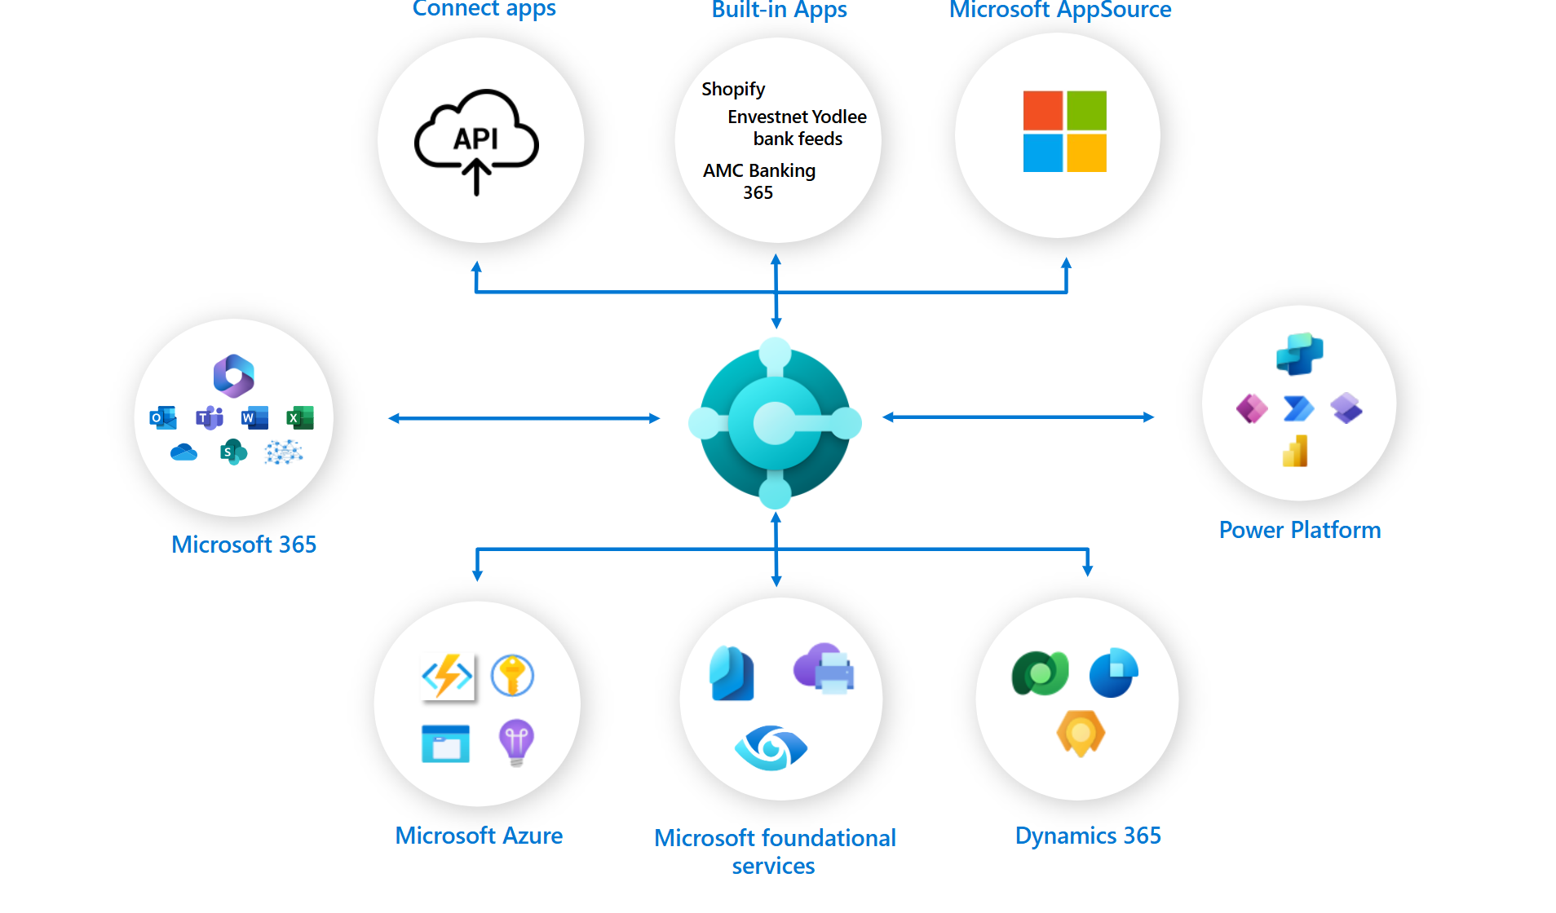
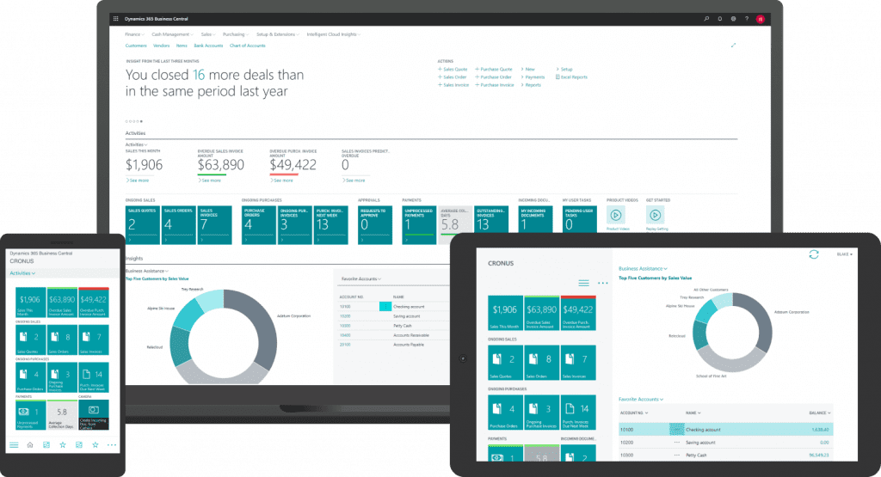
Wanna be an ERP Rockstar?

Slide 8
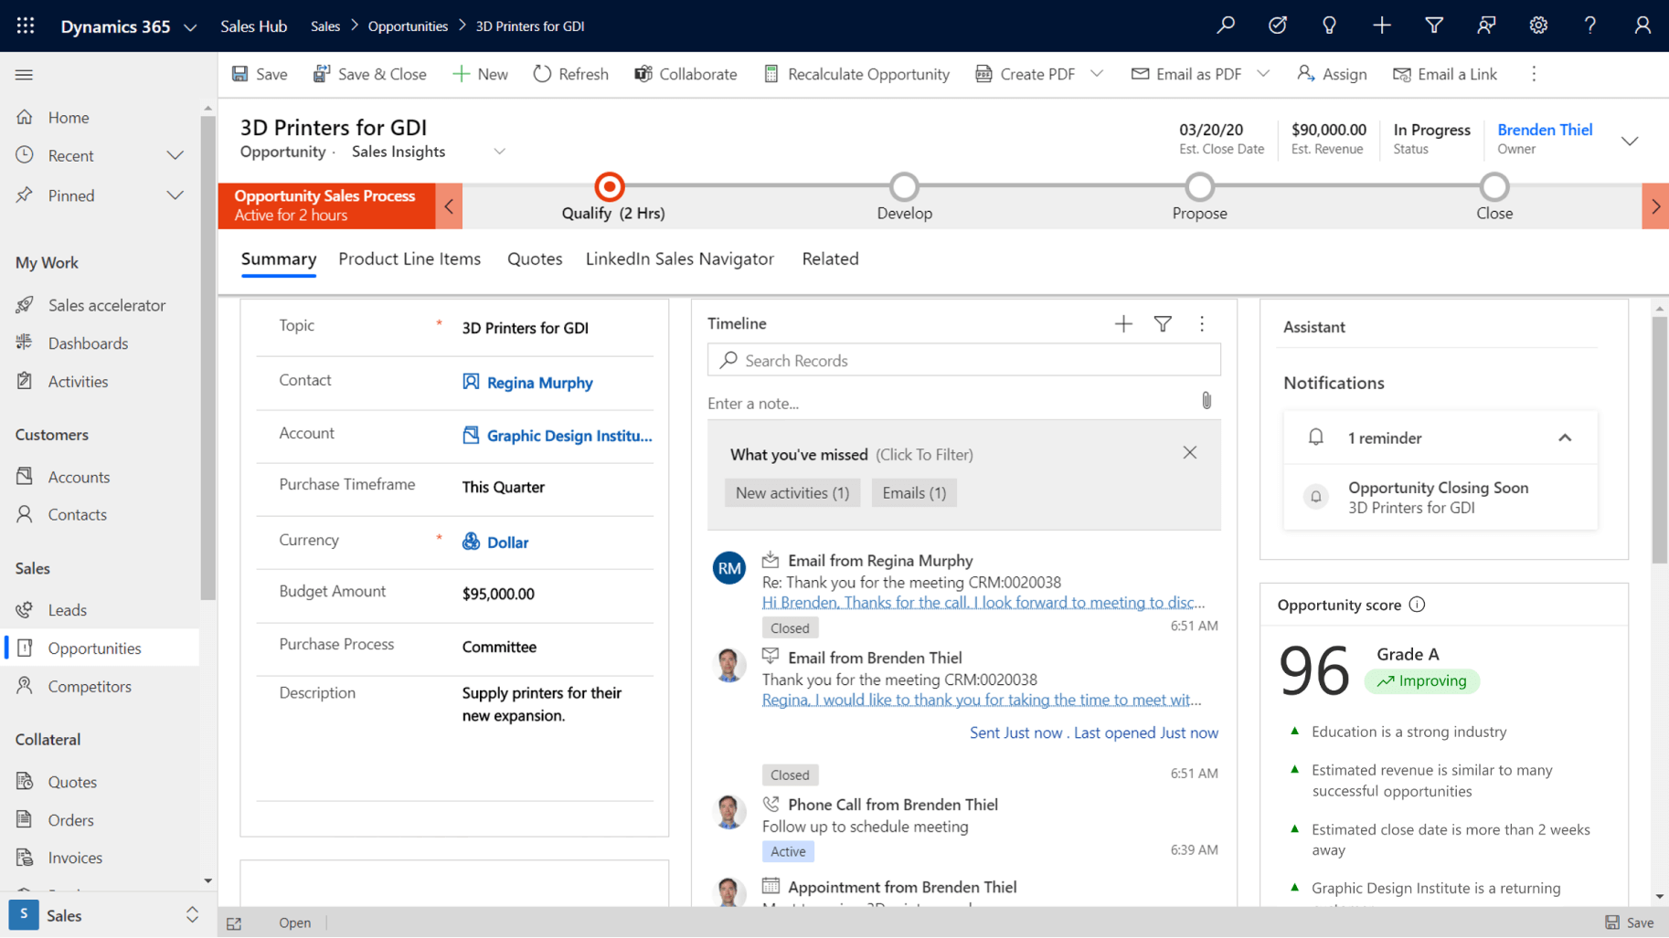
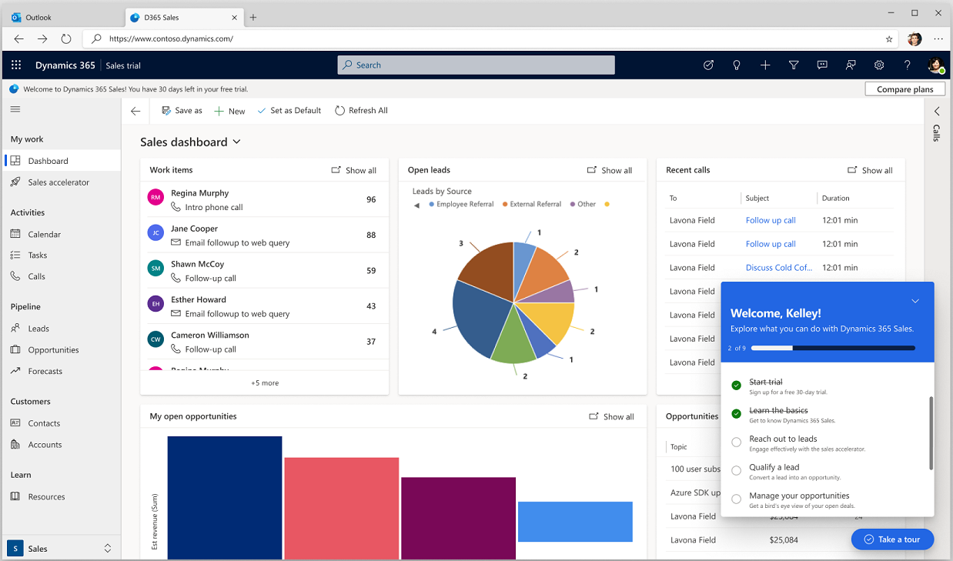
Wanna be a CRM Pilot?

Slide 9
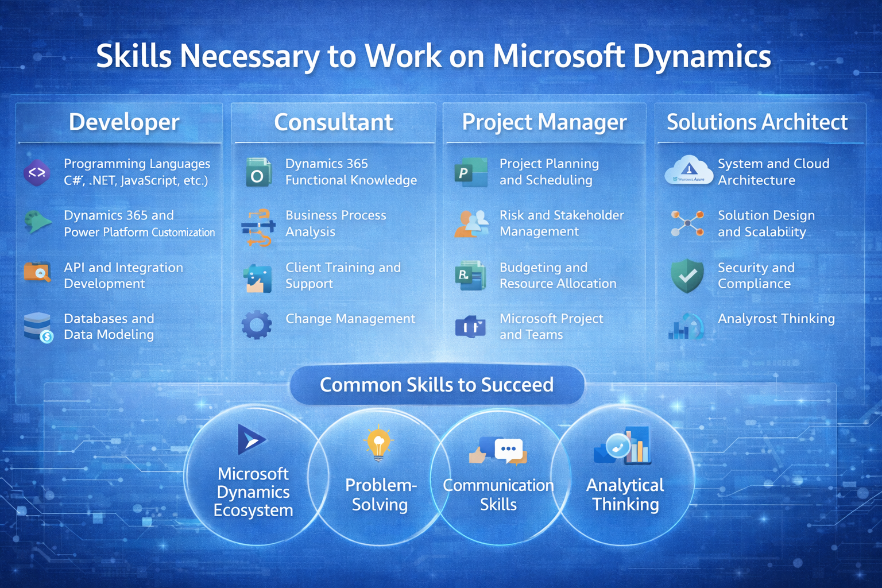
Who are Good candidates?

